Slide 1
AN EFFICIENT ALGORITHM TO SELECT PHONETICALLY BALANCED SCRIPTS FOR CONSTRUCTING A SPEECH CORPUS
Notes:
Lady and gentleman. The title of my paper is AN EFFICIENT ALGORITHM TO SELECT PHONETICALLY BALANCED SCRIPTS FOR CONSTRUCTING A SPEECH CORPUS. My name is 梁敏雄

Slide 2
Introduction
A multilingual speech corpus, containing Taiwanese (Min-nan), Hakka, Mandarin, is constructing in Taiwan
This paper presents a method to choose the phonetically balanced-word scripts for collecting speech database
Notes:
As first, a multilingual speech corpus is constructing in Taiwan containing Taiwanese (Min-nan), Hakka, Mandarin
This paper presents a method to choose the phonetically balanced word scripts for collecting speech database

Slide 3
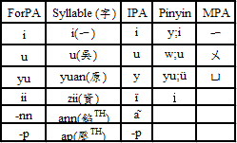
Formosa Phonetic Alphabet (ForPA)
MPA(also called Zhu-in-fu-hao) and Pinyin (Han-yu-pin-yin) are insufficient for Taiwanese and Hakka.
In order to design a more suitable phoneme set for three languages, we design the ForPA.
Fig.1:A partial example of ForPA
Notes:
Before collecting speech database , it’s necessary to design a more suitable phoneme set to begin with multilingual speech data collection and labeling. MPA(also called Zhu-in-fu-hao) and Pinyin (Han-yu-pin-yin) are insufficient for Taiwanese and Hakka. Therefore, we design a phoneme set ForPA for three languages

Slide 4
Formosa Lexicon (ForLex)
 | Mandarin | Taiwanese | Hakka
1-Syl | 6863 | 8027 | 7322
2-Syl | 39733 | 44846 | 9161
3-Syl | 8277 | 12129 | 4948
4-Syl | 9074 | 1823 | 2382
5-Syl | 435 | 161 | 21
6-Syl | 223 | 0 | 3
7-Syl | 125 | 0 | 0
8-Syl | 52 | 0 | 0
9-Syl | 2 | 0 | 0
10-Syl | 8 | 0 | 0
Total | 64792 | 66986 | 23837
A tri-lingual lexicon has been collected to produce word sheets for speakers to utter
  CKIP Mandarin lexicon
  Gang’s Taiwanese lexicon
  Syu’s Hakka lexicon
<Table 1> The distribution of word numbers of CKIP Mandarin , Gang’s Taiwanese, Syu’s Hakka lexicons. (Syl:syllable)
Notes:
After description of ForPA, we also need a tri-lingual lexicon to produce word sheets for speakers. The lexicon contain CKIP Mandarin lexicon, Gang’s Taiwanese lexicon and Syu’s Hakka lexicon. The <Table 1> shows the distribution of word numbers in those lexicon

Slide 5
Requirements of the balanced word scripts
The scripts will cover all possible speech units listed as followed:
  Phones
  Initial-Finals
  Within-syllabic bi-phones
  Right context Initials
  Context independent Finals
  Inter-syllabic right-context-dependent phones
It can be shown that if the scripts include all possible Base-syllables and Inter-syllabic bi-phones, then it will match all the requirements as above.
“Base-syllables” and “Inter-syllabic bi-phones” are thus chosen as the baseline speech units which should be covered in the word scripts
Notes:
In general, the requirements of the balanced word scripts should cover Phones, Initial-Finals, Within-syllabic bi-phones, Right context Initials, Context independent Finals, Inter-syllabic right-context-dependent phones. And It can be shown that if the scripts include all possible Base-syllables and Inter-syllabic bi-phones,then it will match all the requirements as above. Therefore, “Base-syllables” and “Inter-syllabic bi-phones” are chosen as the baseline speech units which should be covered in the word scripts

Slide 6
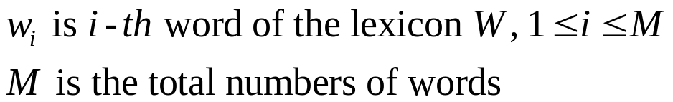












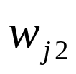
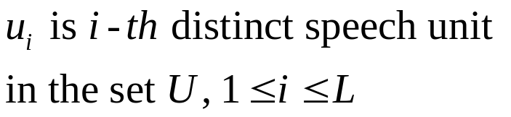
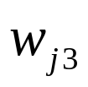

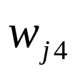
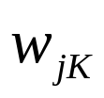
Problem definition
Notes:
In the this slide, we state the problem of phonetically balanced word. This is a global words set in the lexicon and it contains M words. And this is a distinct speech units set from the global words set and it contains L speech units. We want to choose K words as less as possible to cover all possible distinct speech units

Slide 7
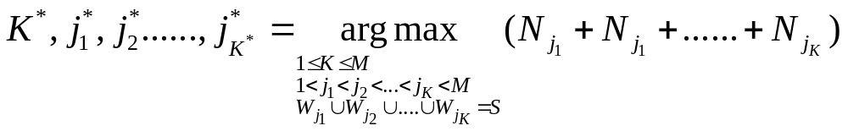
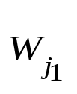


The Problem complexity
Where K is the number of selected words, is a word in the lexicon and when m≠n
If the lexicon has 60000 words, the search space contains candidates,
It’s a NP-complete problem
Notes:
By analysis, the problem also can be described as this equation. If the lexicon has sixty thousand words, the search space contains 2 power sixty thousands candidates. So we can say the problem is a NP-complete problem

Slide 8
The proposed method
Adopt a greedy two-stage solution for selecting the balanced word sets
Choose words based on the principle of words of maximal non-chosen speech units each iteration
Repeat the principle until the words set contains all possible speech units
Notes:
And then the proposed method is a greedy two-stage solution for selecting the balanced word sets. And Choose words based on the principle of words of maximal non-chosen speech units each iteration. Then Repeat the principle until the words set contains all possible speech units

Slide 9

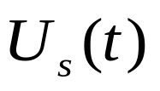


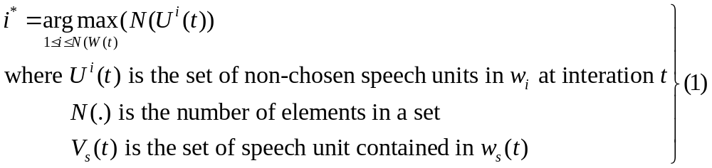
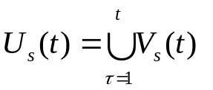
The description of the algorithm(1)
Notes:
the algorithm can be described as transcription in detail. In this global words set we try to choose a word ws of t to satisfy the equation. Where the ui of t is the set of non-chosen speech units in word I at iteration t. and N(.) is the number of elements in a set. Vs of t is the set of speech units contained in ws of t. it can be shown by the above conditions

Slide 10
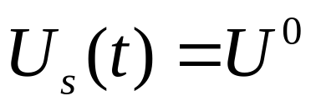
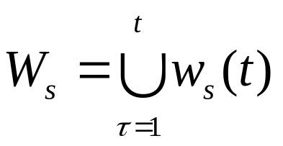
The description of the algorithm(2)
We repeat (1) until
And the final set of words is
Notes:
And we repeat the equations (1), until us of t equal u zero. Finally, we can get a set of phonetically-balanced words ws

Slide 11
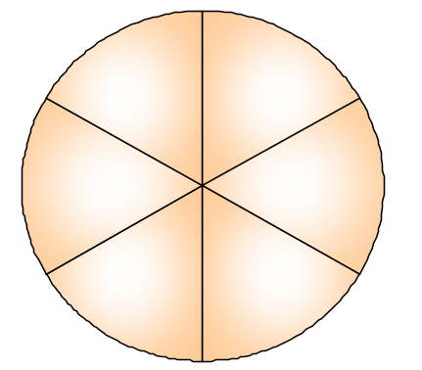


Step 1
Initially set the non-chosen word and speech units set to be the whole word set
t=0, W(t)=W(0), S(t)=S(0), P(t)=P(0) from ForLex
  Example:
    W(0)={昨天,天氣,梁敏雄, 天天}
    S(0)={zuo, tian, ci, liang, min, siong}
    P(0)={o+t, n+c, ng+m, n+s,n+t}
S(0)
zuo
tian
昨天(zuo-tian)
W=W(0)
w₀
siong
ci
P(0)
o+t
n+s
天天(tian-tian)
天氣(tian-ci)
min
liang
w₃
w₁
n+c
ng+m
w₂
n+t
梁敏雄(liang-min-siong)

Slide 12

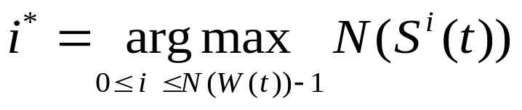
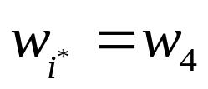
Step 2
Step2: Choose the word for
  Example:
    i*=3 for t=0, where w₂=梁敏雄
Continue step 3
S²(0)
W
昨天(zuo-tian)
w₀
siong
天天(tian-tian)
天氣(tian-ci)
S²
w₃
w₁
min
liang
w₂
: selected a word which contains the most non-chosen speech units
梁敏雄(liang-min-siong)

Slide 13






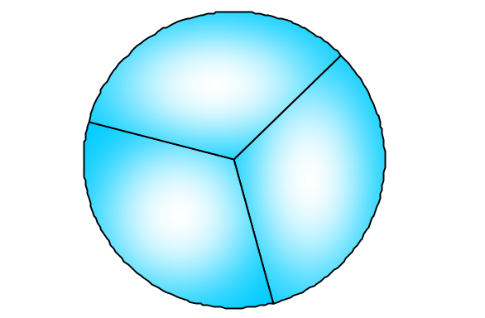
Step 3
We repeat step 2 , i.e. “choose the word with maximal non-chosen speech units” until all speech units has been chosen
W(0)
昨天(zuo-tian)
w₀
S(0)
zuo
P(0)
tian
o+t
n+s
天天(tian-tian)
天氣(tian-ci)
siong
ci
w₃
w₁
n+c
ng+m
min
liang
n+t
w₂
梁敏雄(liang-min-siong)
S(1)
W(1)
昨天(zuo-tian)
P(1)
w₀
zuo
tian
o+t
n+c
天氣(tian-ci)
天天(tian-tian)
w₁
ci
n+t
w₃

Slide 14
Step 4
If we have additional speech units like inter-syllabic bi-phones, repeat the steps from step 1 and step 3
Example:
    i*=3 for t=3, where w₄=天天
P(3)
W(3)
n+t
天天(tian-tian)
w₃
P(4)
W(4)

Slide 15
Why the algorithm is efficient but not optimal
We just need to consider all possible Base-syllables and Inter-syllabic bi-phones
The statistics of table 2 show that we collect one distinct base-syllable and inter-syllabic bi-phone for every 2.63 base-syllables and 2.08 inter-syllabic bi-phone
 | Base-syllable | Inter-syllabic bi-phones
The number of distinct speech units | 832 | 716
The number of speech units in scripts | 2190 | 1491
<Table 2> The statistics of speech units of the phonetically-balanced word script

Slide 16
Data sheets (1)
Produce balanced-word sets
  The process of data sheets is also a two-stages solution, and the stage-1 is shown bellow
  As shown following flow chart, we collect phonetically balanced-word sets exhaustively in the ForLex
Balanced-
word algorithm
One Balanced
word set
Residual words
after algorithm
ForLex
Stage 1
Notes:
In order to collect speech data with as much information about phonetic variations, we collect not only one balanced-word set

Slide 17
Data sheets (2)
The process of stage-2 is showed bellow
Example for Taiwanese:
  The number of data sheets are 446, and the number of total words are 37275 which is half of the number of Taiwanese lexicon in ForLex.
Balanced-
word sets
Coverage
rate > 50%
Y
Merge
Segment equally by 200
syllables for each sheet
Data sheets
N
Delete
Stage 2

Slide 18
Database information
The database has been collected in both microphone and telephone channel
  ForSDat-Mic600
  ForSDat-Tel1000
 | Length for MIC- channel | Length for TEL- channel
Read speech | 24.3 hr | 16 hr
<Table 3>The statistics of utterances in microphone and telephone channel for Taiwanese (MIC: microphone, TEL: telephone)
 | The number of Speaker for MIC channel | The number of Speaker for TEL channel
Male | 328 | 626
Female | 291 | 425
Total | 619 | 1051
<Table 4> The statistics of speakers in microphone and telephone channel for Taiwanese (MIC: microphone, TEL: telephone)

Slide 19
Conclusion
By adopting the balanced-word algorithm The version 1.0 of this corpus has been collected
  Contain Taiwanese (Min-nan) and Mandarin Chinese
  1773 people, 40.30 hours and 247,027 utterances.
The project is on going, so more speech data of Hakka and Mandarin will be collected.

